Slide 1
DIABETES MELLITUS AND COMPLICATIONS
DR MARK MUTUMA

Slide 2
Definition
Diabetes mellitus (DM) is a group of diseases characterized by high levels of circulating blood glucose resulting from defects in insulin production, insulin action, or both.
A metabolic disorder of multiple aetiology characterized by chronic hyperglycaemia with disturbances of carbohydrate, fat and protein metabolism resulting from defects in insulin secretion, insulin action, or both

Slide 3
Classification (ADA)
I. Type 1 diabetes (β-cell destruction, usually leading to absolute insulin deficiency)
A. Immune mediated
B. Idiopathic
II. Type 2 diabetes (may range from predominantly insulin resistance with relative insulin deficiency to a predominantly secretory defect with insulin resistance)

Slide 4
Type 1 DM
Previously called insulin-dependent diabetes mellitus (IDDM) or juvenile-onset diabetes.
Due to immune destruction of pancreatic beta cells.
This form of diabetes usually strikes children and young adults, although disease onset can occur at any age.
Type 1 diabetes may account for 5% to 10% of all diagnosed cases of diabetes.
Risk factors for type 1 diabetes may include autoimmune, genetic, and environmental factors.

Slide 5
Type 2 DM
Previously called insulin-dependent diabetes mellitus (IDDM) or juvenile-onset diabetes.
Due to immune destruction of pancreatic beta cells.
This form of diabetes usually strikes children and young adults, although disease onset can occur at any age.
Type 1 diabetes may account for 5% to 10% of all diagnosed cases of diabetes.
Risk factors for type 1 diabetes may include autoimmune, genetic, and environmental factors.

Slide 6
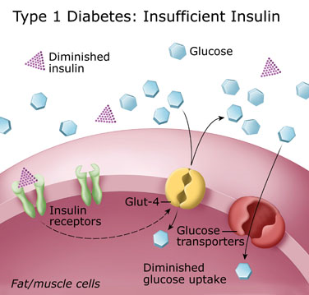
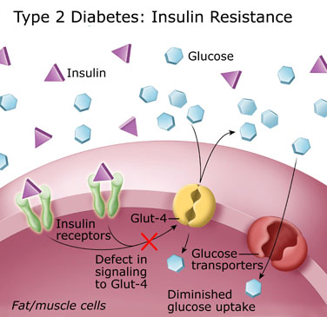

Slide 7
Type 1 DM
60% of new diagnosed of DM in patients ≤ 19 years.
The incidence of T1DM varies based on:
  Age- Bimodal peak=4-6 & 10-14 yrs
  Geography- Rising worldwide, Highest in Finland & Sardinia lowest in china & Venezuela
  Gender- there appears to be no gender preference (male=female)
  Family history. > Risk [50% monozygotic twins -0.4 % if no family Hx]
  Environmental factors.- Viral infections, Diet (cow milk), immunizations, Vit. D def, Perinatal factors e.g. Maternal age, PET, LBW, Seasonal Variations

Slide 8
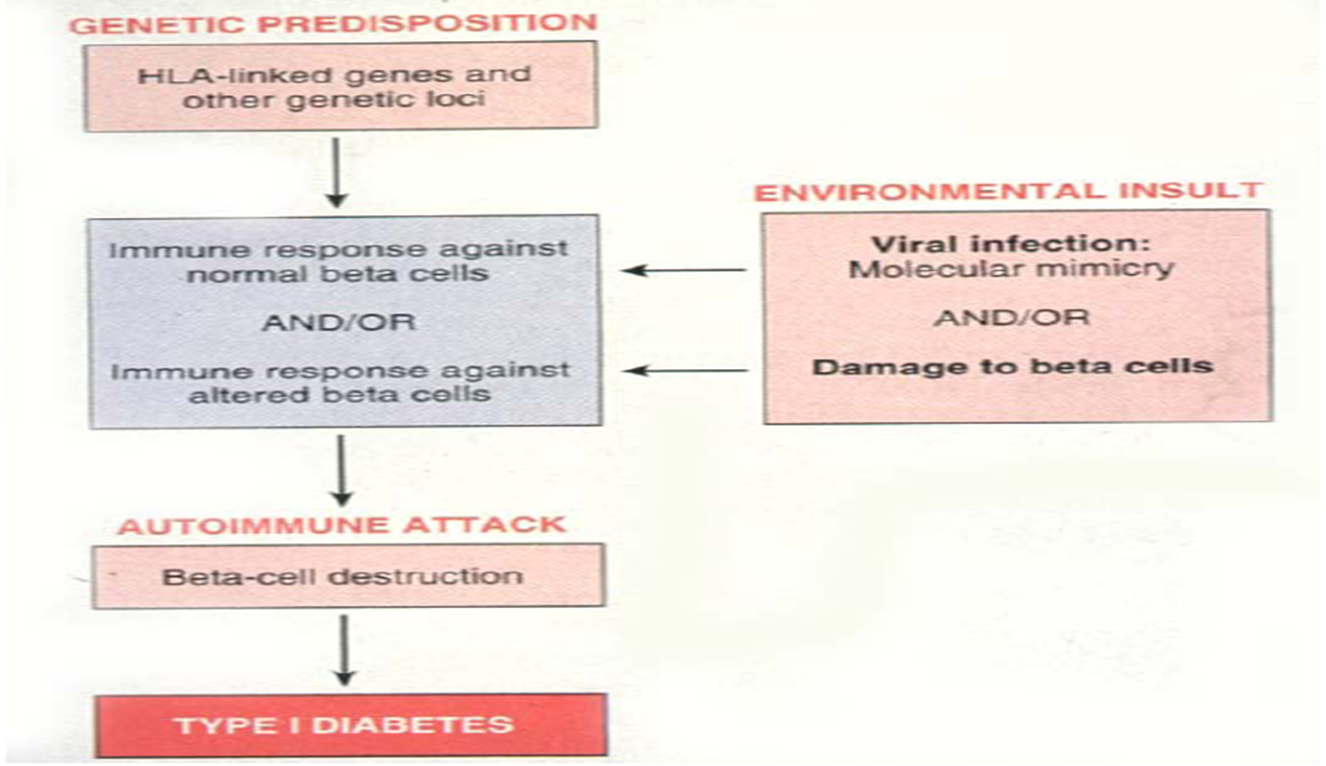
pathogenesis

Slide 9
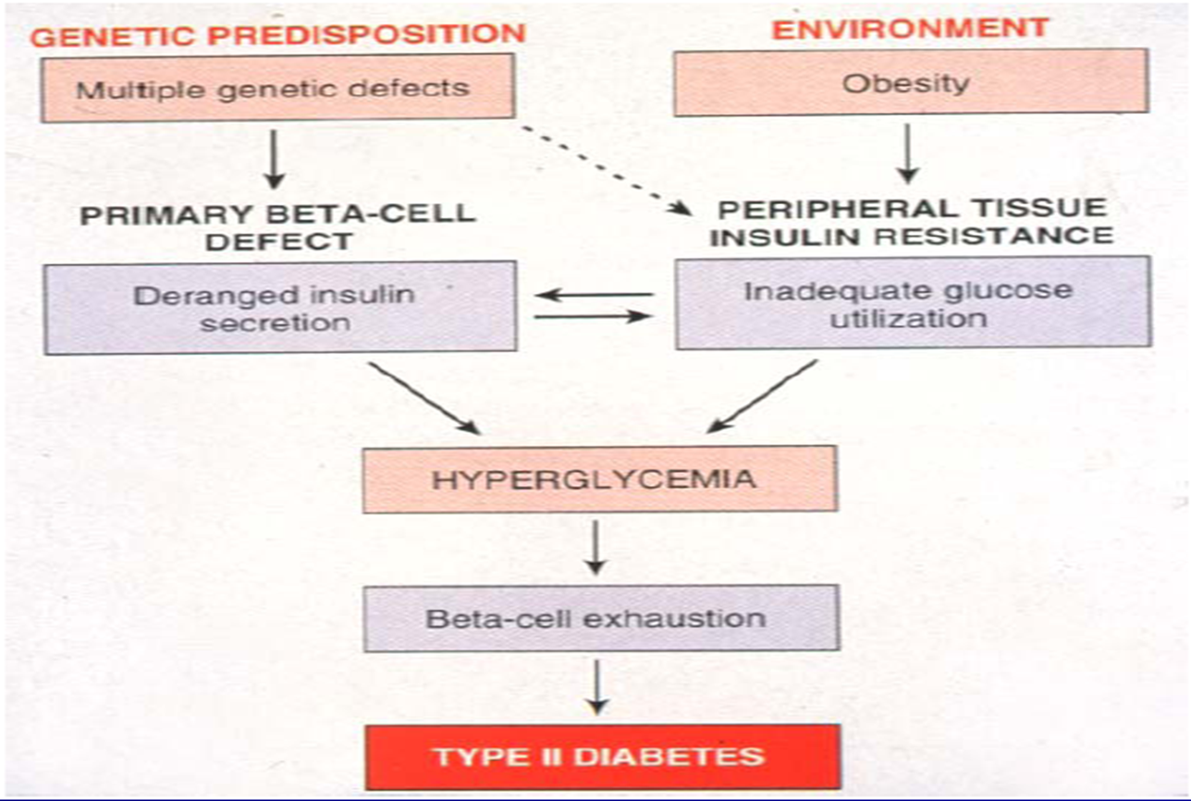

Slide 10
CLINICAL FEATURES

Slide 11
Symptoms
Polydipsia
Polyuria
polyphagia
Nocturia
Fatigue
Recent change of weight
Blurring of vision, pruritus vulvae
Nausea, vomiting, headache
Notes:
Dehydration and catabolism responsible for the fatigue.

Slide 12
Signs
Focus on the following areas:
  Eyes (cataracts, visual acuity, fundoscopy)
  Hands (cheiroarthropathy, Dupuytren’s contracture )
  Blood Pressure
  Insulin Injection sites (Lipodystrophy)
  Feet (sensation, pulses, ulcers)
Notes:
o/e findings

Slide 13
Diagnostic Criteria
1. FPG ≥126 mg/dl (7.0 mmol/l). Fasting is defined as no caloric intake for at least 8 h.*
OR
2. Symptoms of hyperglycemia and a casual plasma glucose ≥200 mg/dl (11.1 mmol/l). Casual is defined as any time of day without regard to time since last meal. The classic symptoms of hyperglycemia include polyuria, polydipsia, and unexplained weight loss.
OR
3. 2-h plasma glucose ≥200 mg/dl (11.1 mmol/l) during an OGTT. The test should be performed as described by the World Health Organization, using a glucose load containing the equivalent of 75 g anhydrous glucose dissolved in water.*
Notes:
↵* In the absence of unequivocal hyperglycemia, these criteria should be confirmed by repeat testing on a different day.

Slide 14
Lifestyle Management
Nutritional Therapy
Physical activity
Smoking cessation
Psychosocial issues

Slide 15
Pharmacological options
Insulin
Oral antidiabetics

Slide 16
Biguanides
Metformin
  Dec hepatic glucose production
  Dec GI glucose absorption
  Inc target cell insulin sensitivity
  Dosage:
  500mg PO q12hr/850mg PO qDay (Initial)
  1500-2550mg/day PO – Divide BD or QID with meals (maintenance)
  don’t exceed 2550mg/day

Slide 17
Sulfonylureas
Initial effect is inc insulin secretion
      Chlorpropamide
      Glimepiride
      Glipizide
      Tolbutamide
- can be used with metformin as a combination

Slide 18
Amylinomimetics
  Pramlintide
  Symlin
Analogues of hormone Amylin – suppresses glucagon, delay gastric emptying and regulate appetite
Notes:
Amylin - satiety

Slide 19
Meglitinides
    Nateglinide
    Repaglinide
    Prandin
    Inc insulin secretion by binding K+ channels on Beta cells.

Slide 20
Alpha-Glucosidase Inhibitors
Acarbose
Miglitol
Inhibition of oral pancreatic alpha amylases and intestinal brush border alpha glucosidases.
The effect is delayed hydrolysis of ingested carbs and absorption
Notes:
Metabolism of glucose starts in the mouth. Salivary amylase

Slide 21
Dipeptyl Peptidase-IV Inhibitors
Sitagliptin
Prolongs incretin hormone activity
Incretins increase insulin release and inhibit glucagon release.

Slide 22
GLP-1 Agonists
Incretin mimetics
Dulaglutide

Slide 23
Thiazolidinediones
Pioglitazone
Rosiglitazone
Inc sensitivity of target cell to insulin
Dec hepatic gluconeogenesis
* depends on presence of insulin for activity

Slide 24
SGLT2 Inhibitors
SGLT2 expressed in proximal renal tubules for reabsorption of glucose.
Inhibition effectively reduces glucose reabsorption and increases urinary glucose excretion
Empagliflozin

Slide 25
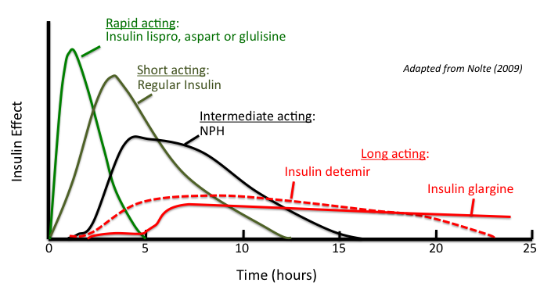
Insulin
Notes:
Rapid – inhaled insulin
Long acting: Degludec, levemir,
Rapid acting insulin • 5-15 min before meals
Short acting insulin • 20-30 min before meals
Intermediate acting Isophane (NPH) insulin • Twice or thrice a day
Long acting insulin preparations • once or twice a day to provide basal insulin level

Slide 26
TYPE 1 DM
Patient education
• Strict glycemic control- insulin
• Prevent DKA
• Meals/ diet
• Weight management and Exercise
• Transplantation: islet cells or pancreas

Slide 27
cont
Insulin is the mainstay therapy.
Pramlintide – for adults(weight loss and lower insulin doses)
Investigational
  Metformin
  Incretin based therapies
  SGLT2 Inhibitors
  Surgical – Pancreas and Islet transplant

Slide 28
TYPE 2 DM
Microvascular (eye, kidney disease) risk reduction through control of glycemia and blood pressure.
Macrovascular (Coronary, cerebrovascular, peripheral vascular) risk reduction through control of lipids and hypertension, smoking cesstion
Metabolic and neurologic risk reduction through control of glycemia.
Notes:
Limit salt, alcohol and caffeine ✓Carbohydrate 45-60% energy, protein 10-15% and fat <35% (saturated and polyunsaturated

Slide 29
cont
1. Metformin
2. Insulin Therapy
3. Dual therapy – newly diagnosed with HbA1c value above 9
4. Triple therapy
Empaglifozin and Liraglutide – proven to reduce major adverse cardiovascular effects
Notes:
Metformin long term use risk vit b12 deficiency.
Insulin – symptomatic + A1c above 10 + more than 16.7mmol/L
After 3 months and not better A1c add a 3rd antihydiabetic
Patient centered and follow up

Slide 30
ACUTE COMPLICATIONS
Diabetes ketoacidosis (DKA)
Hyperosmolar hyperglycemic state (HHS)
Hypoglycemia

Slide 31
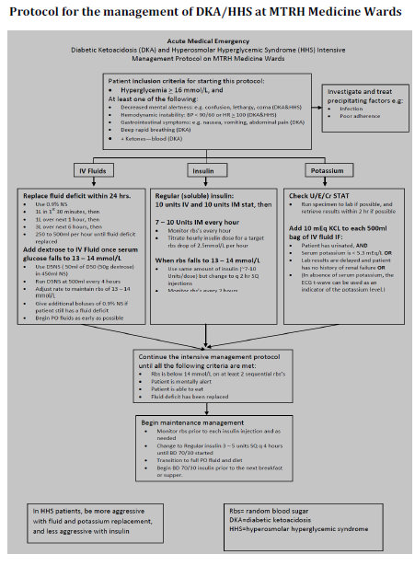

Slide 32
CHRONIC DM COMPLICATIONS
Macrovascular
Coronary artery disease
Peripheral arterial disease
Cerebrovascular disease

Slide 33
Microvascular
Eye disease
Retinopathy (nonproliferative/proliferative)
Macular edema
Neuropathy
Sensory and motor (mono- and polyneuropathy)
Autonomic
Nephropathy

Slide 34
Avascular
  Genitourinary (uropathy/sexual dysfunction)
Dermatologic
Infectious
Cataracts
Glaucoma
Periodontal disease

